Slide 1

Multi-Threading Merge Sort
Increasing speed via parallel computation.

Slide 2

Lets Talk about Merge-Sort
Lets get Serial…

Slide 3
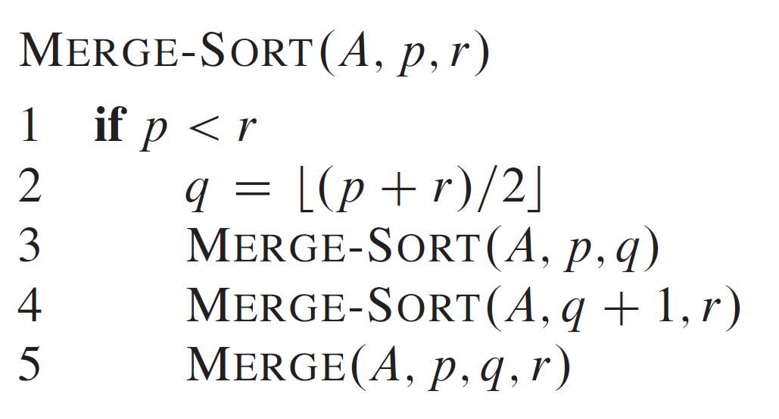
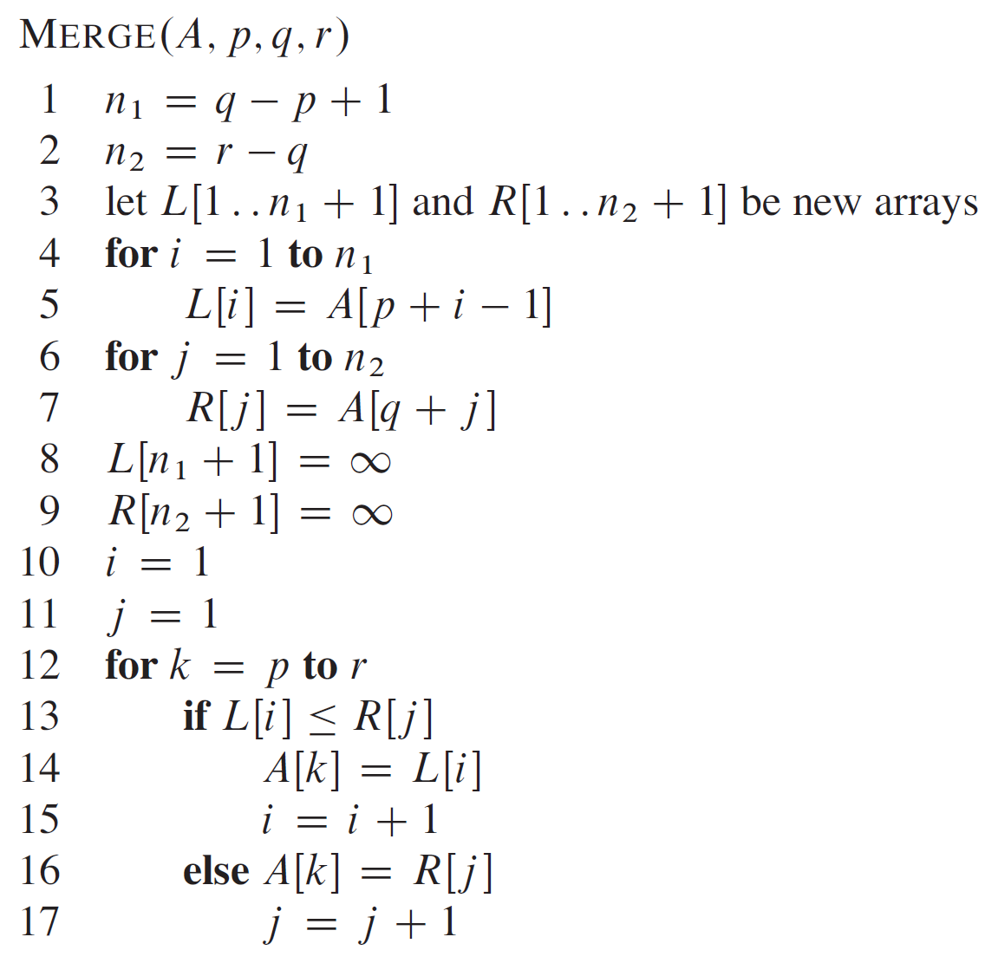
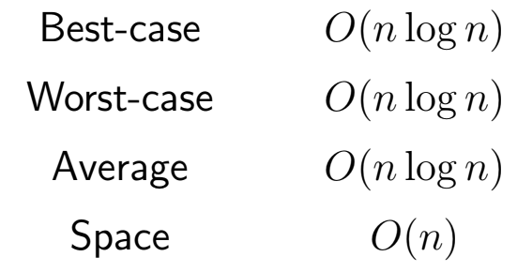
Merge-Sort
Serial Processing

Slide 4

Dynamic Multi-Threaded Processing
Simply put - It’s a scheduling problem
Allows the programmer to specify parallelism in application without worrying about communication protocols, and load balancing. This is due to the concurrency platform.
Why so Serial?

Slide 5

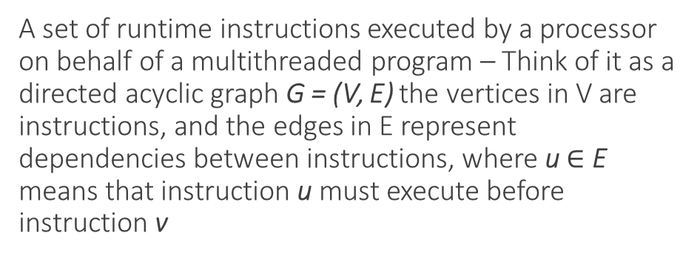
Multithreaded Computation
A set of runtime instructions executed by a processor on behalf of a multithreaded program – Think of it as a directed acyclic graph G = (V, E) the vertices in V are instructions, and the edges in E represent dependencies between instructions, where u $∈$ E means that instruction u must execute before instruction v
Some terms you'll need to know.
Nested Parallelism: a subroutine to be “spawned”, allowing the caller to proceed while the spawned subroutine is computing its result.
Nested Loop: like a for loop but the iterations of the loop can have concurrent executions.
Parallel: threads processing information concurrently
Spawn: generates a new thread to process while the original thread runs concurrently along aide it.
Sync: Holds the current processing until all previous spawn threads return.
Concurrency: the ability for an algorithm to process data out of order without affecting the final result.
Work: total time to execute the entire computation on one processor.
Span: the longest time to execute the strands along any path in the DAG.

Slide 6





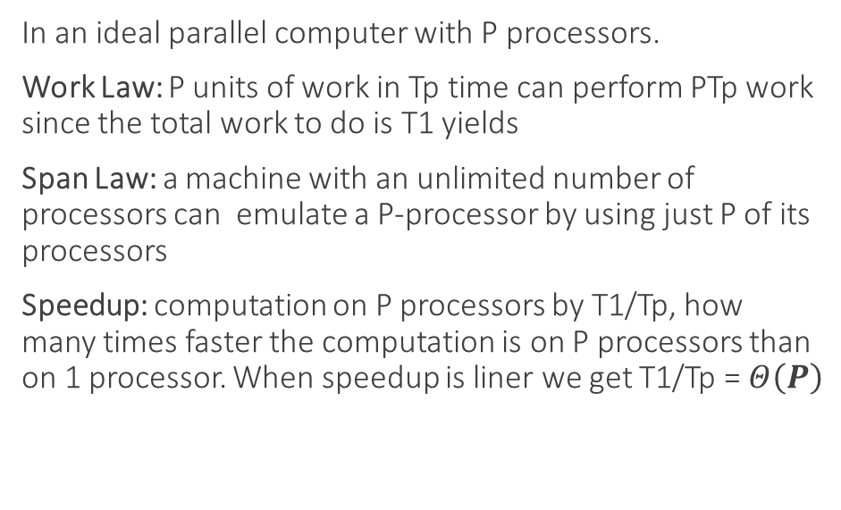
Multithreaded Computation Continued
A multithreaded computation depends not only on its work and its span, but also on how many processors are available and how the scheduler allocates strands to processors.
Work and Spawn provide the lower bound on running time Tp of a multithreaded computation on P processors.
In an ideal parallel computer with P processors.
Work Law: P units of work in Tp time can perform PTp work since the total work to do is T1 yields
Span Law: a machine with an unlimited number of processors can emulate a P-processor by using just P of its processors
Speedup: computation on P processors by T1/Tp, how many times faster the computation is on P processors than on 1 processor. When speedup is liner we get T1/Tp = $Θ\left(P\right)$

Slide 7
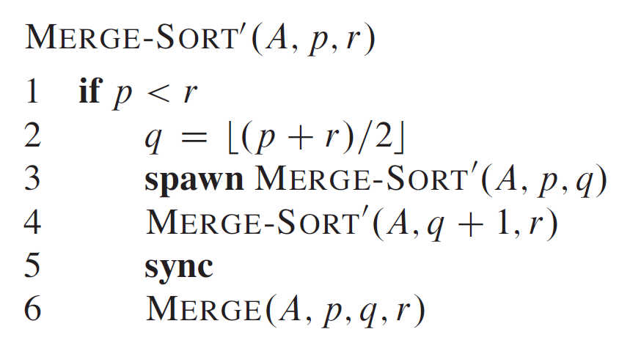
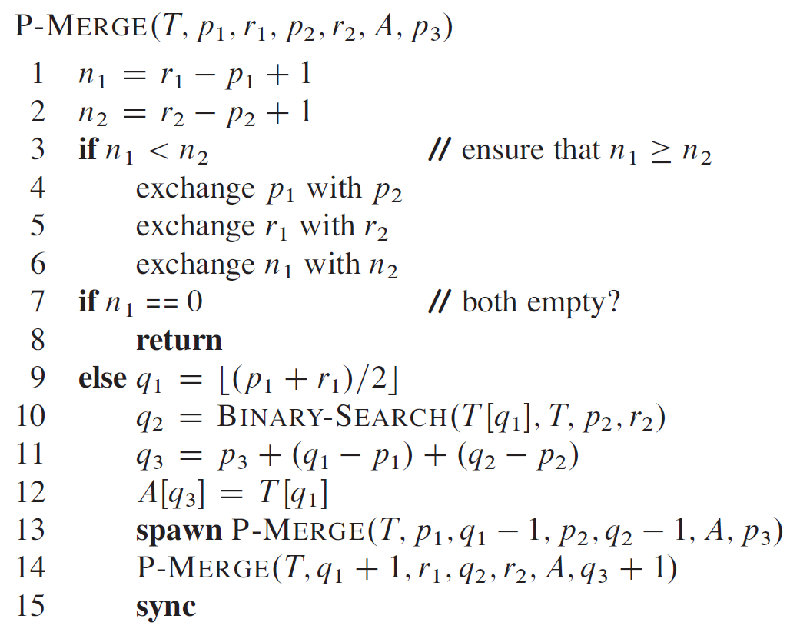
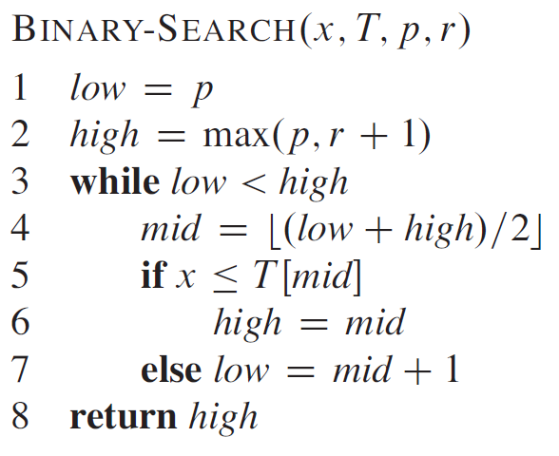
Multi-Threaded Merge Sort

Slide 8
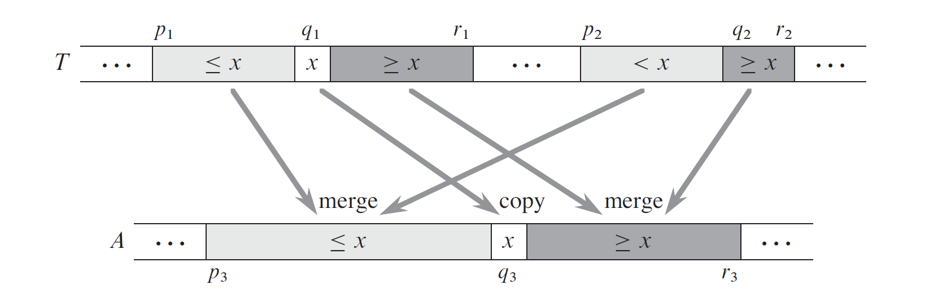
Multi-Threaded Merge Sort
Parallel Merge Operation
The idea behind the multithreaded merging of two sorted subarrays is splitting the arrays across multiple processors p1 and p2. This allows the work to be divided and run concurrently. The trick is knowing how to merge back into P3 as you no longer have the advantage of having a single list nor an adjacent list to work from.

Slide 9

Multi-Threaded Merge Sort
Time Complexity
Binary Search $Θ$(lg n)
Parallel P-merge $Θ$(n / lg^2 n)
P-MergeSort $Θ$( n / lg^2 n )
Enough with the talking already… GIVE ME DEMO

Slide 10


Thank You
Matthew Stroble
mssgwb@mst.edu

